Slide 1
N.C. a&t state university: The state of the university
Harold L. Martin, Sr.
Chancellor
Faculty-Staff Institute
08/04/20

Slide 2
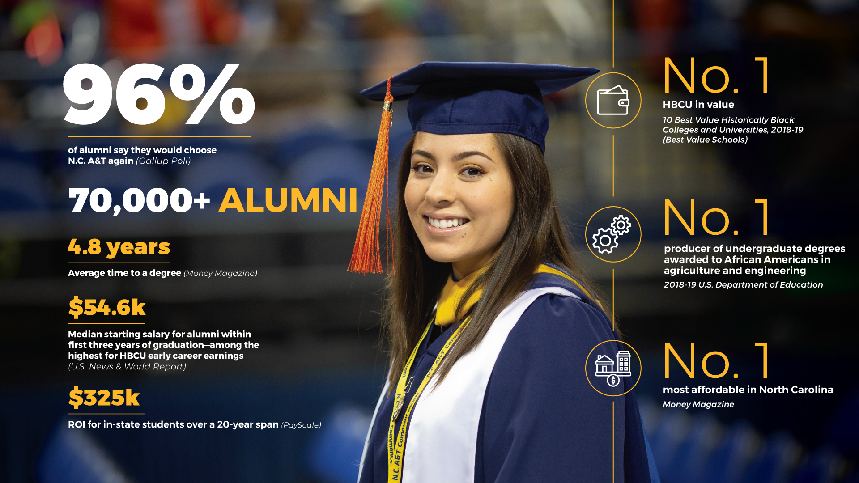

Slide 3
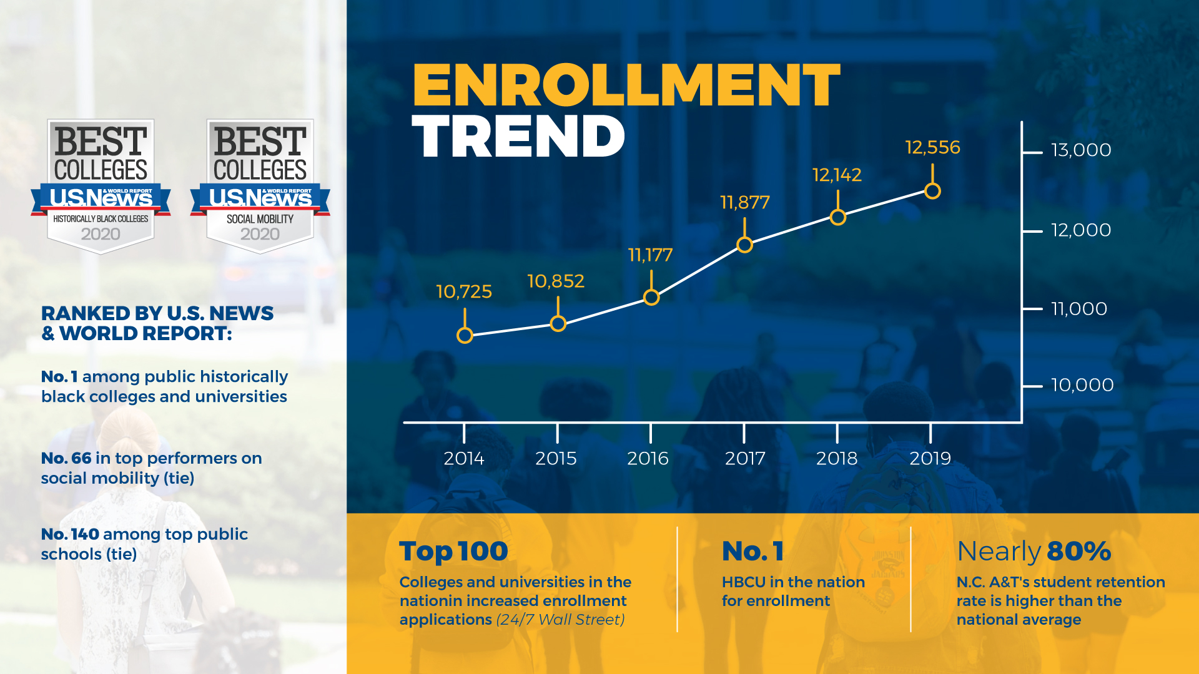

Slide 4
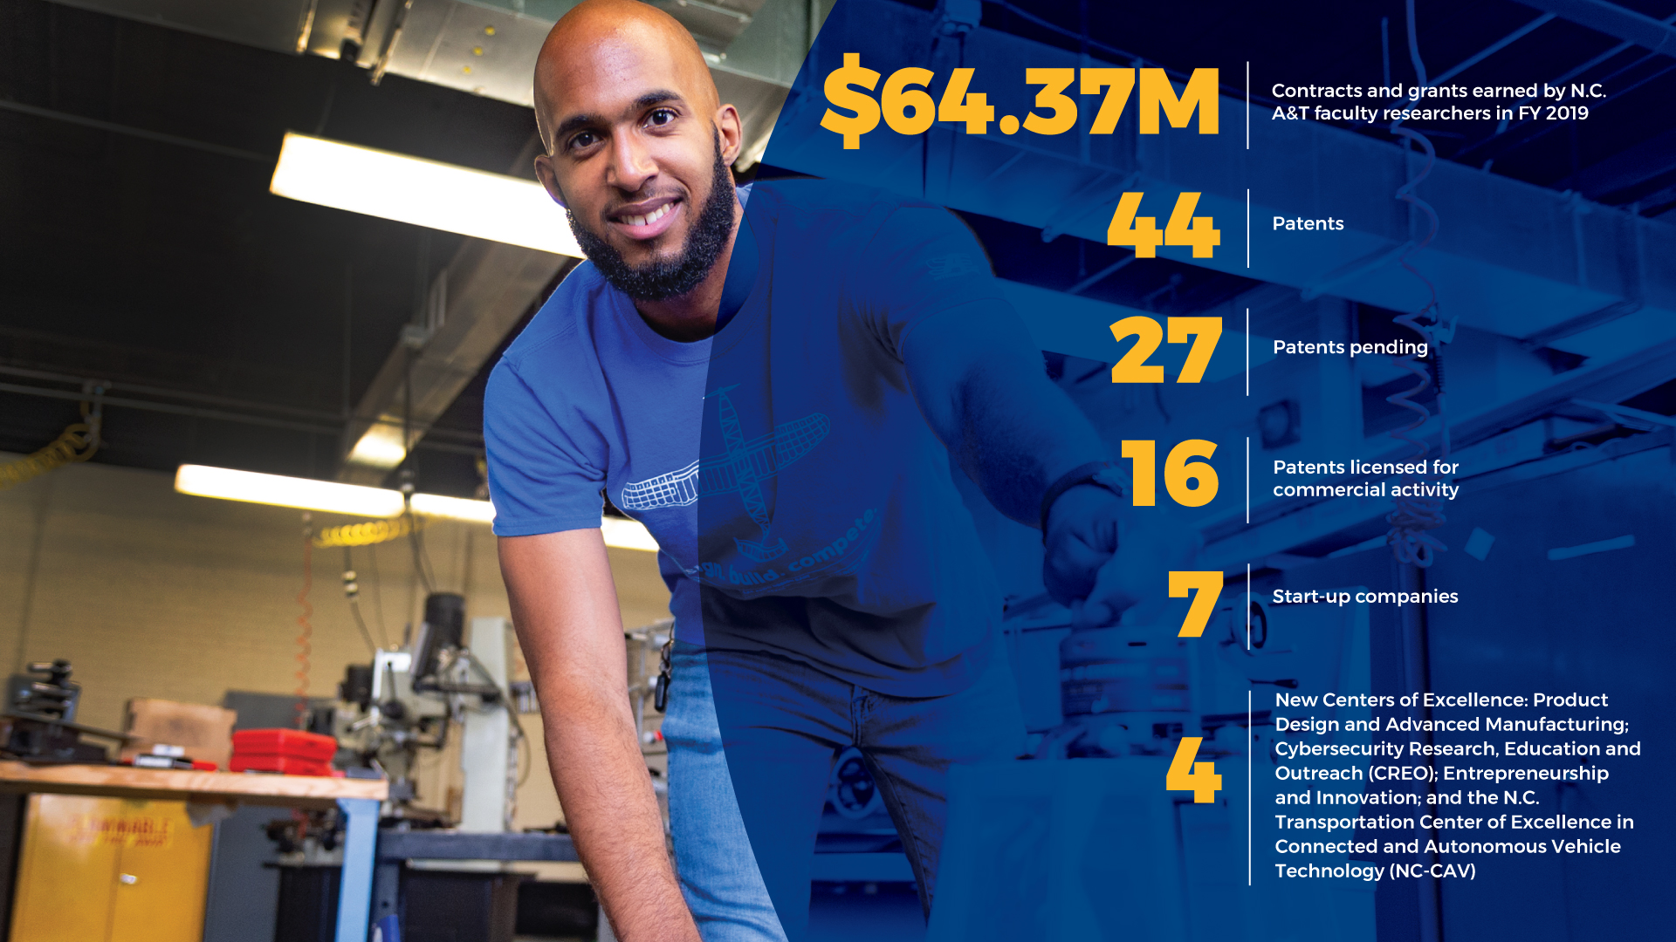

Slide 5
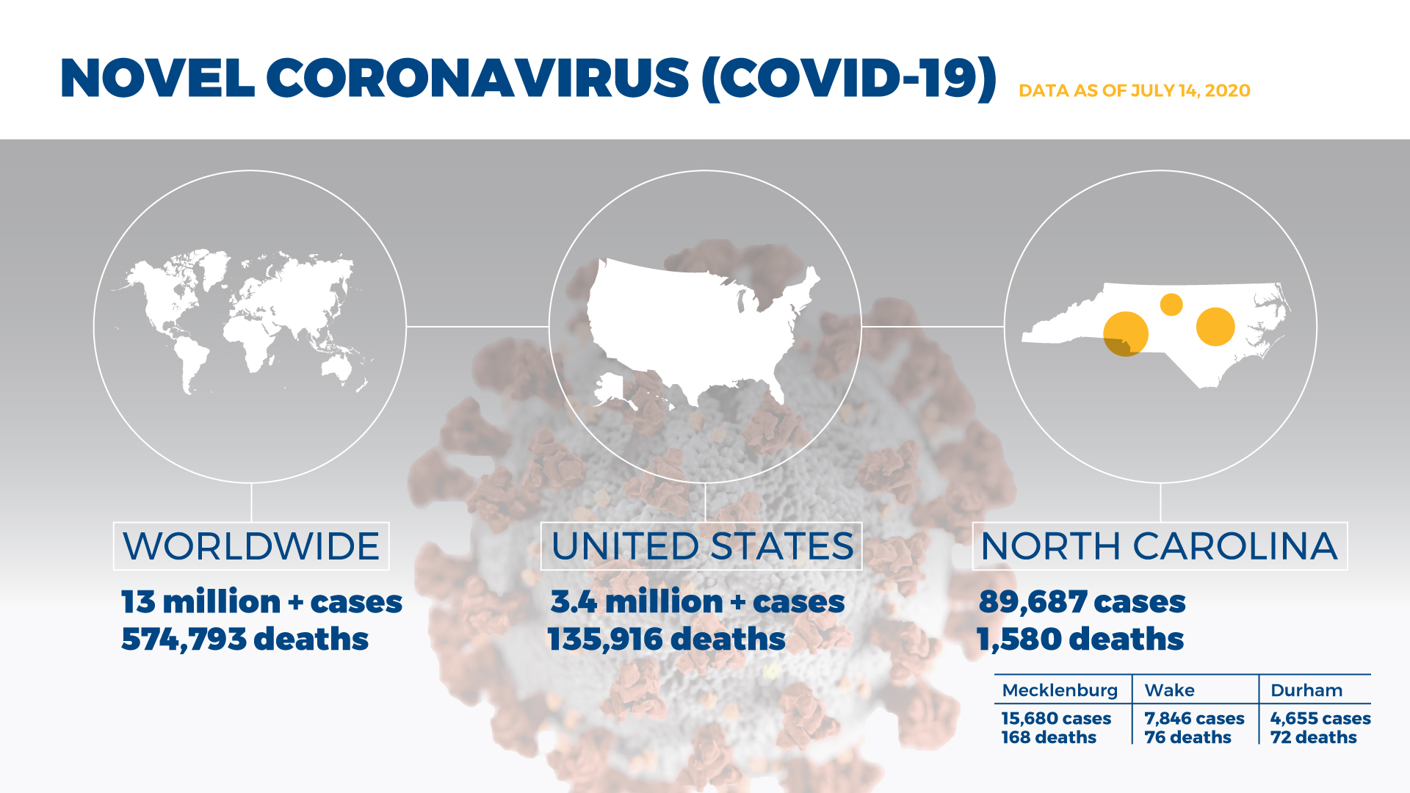
Pandemic Picture

Slide 6
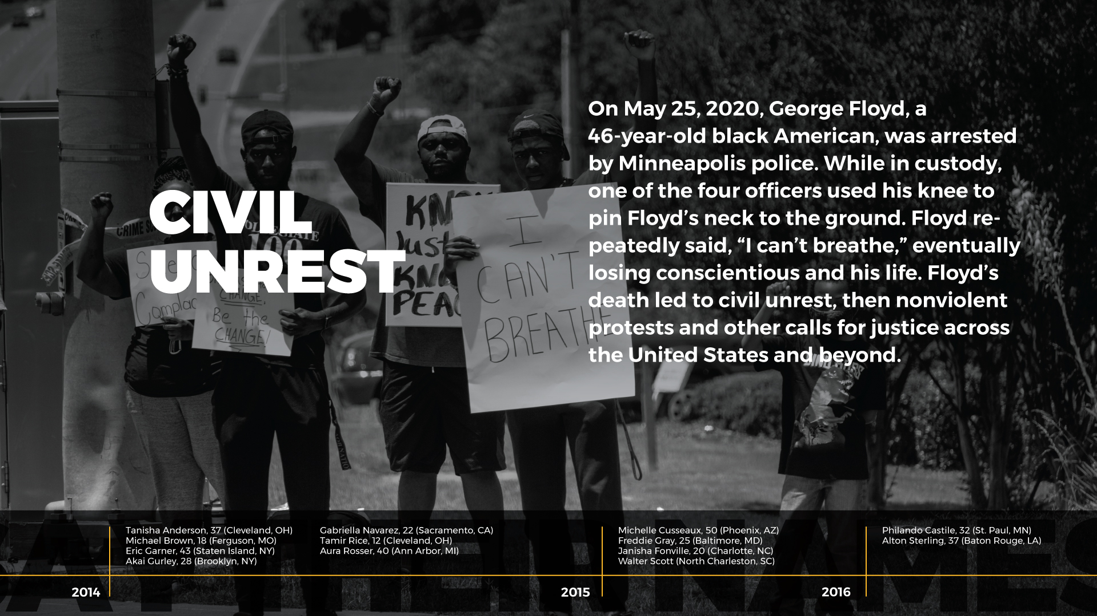
Social Unrest Picture

Slide 7
DO WE WANT TO BE TRANSFORMATIVE?

Slide 8
DO WE WANT TO BE TRANSFORMATIVE?
Questions posed at Faculty-Staff Institute in 2019
Do we want to become a significant economic driver for the State, Piedmont Triad Region, and East Greensboro?
Should we understand the most critical needs of our community and forge relevant partnerships to help solve them?
Should we aspire to be among the national leaders in America in producing graduates in areas of critical need?

Slide 9
WHY SHOULD WE WANT TO BE TRANSFORMATIVE?
Land-Grant Mission
N.C. A&T was created by the Second Morrill Act, in 1890, which expanded the system of land-grant universities to include historically black institutions in states where segregation denied minorities access to the land-grant institution established by the First Morrill Act, in 1862.
The land-grant mission is to expand access and improve student success to deliver the innovative workforce of tomorrow; advance and promote research and discovery to improve society, foster economic growth, address global challenges; and build healthy, prosperous, equitable, and vibrant communities locally and globally.

Slide 10
OPPORTUNITIES TO TRANSFORM

Slide 11
AMERICA’S OPPORTUNITY GAPS: BY THE NUMBERS
Systematic Barriers to Equality of Opportunity for Black Americans and People of Color
The US Chamber of Commerce launched the Equality of Opportunity Initiative to address opportunity gaps that perpetuate broader inequalities in our society and hold back individual and business success and economic growth
Research shows the magnitude of opportunity gaps in Education, Employment, Entrepreneurship, Criminal Justice, Health and Wealth Disparity.
https://www.uschamber.com/report/america-s-opportunity-gaps-the-numbers

Slide 12
EDUCATION
60% of Black students attend a high-poverty, majority-minority school. The average per pupil spending in high-poverty, non-white school districts is $1,500 less than the national average.
Only 1 in 5 Black 4th graders are reading on grade level compared to half of the white students. Just 14% of Black 8th graders are on grade level in mathematics, 20% below the rate for all students combined.
As students get older, roughly 45% of Black students receive no formal education beyond high school and only 15.3% receive a bachelor’s degree, compared to more than 23% of white students.

Slide 13
EMPLOYMENT
For the past four decades, Black unemployment rates have been consistently twice as high as white unemployment.
Black and Hispanic workers with a bachelor’s degree and higher had lower median weekly earnings ($1,065 and $1,101 respectively) than Asians and whites ($1,465 and $1,342).
COVID-19 has exacerbated these differences. Black unemployment rose to 16.8% in May, up from 6.0% in January 2020, as compared to white unemployment which was 12.4% in May and 3.1% in January. During the pandemic, Black (23%) and Latino (24%) workers were more likely than white (15%) and Asian Americans (13%) to have been laid off.

Slide 14
ENTREPRENEURSHIP
Black Americans are underrepresented among entrepreneurs, representing 12% of the U.S. labor force but only 9.4% of business owners.
Given that 70.6% of Black entrepreneurs rely on personal and family savings for financing, lower family wealth overall drives more of a divide in access to capital.
In addition, Black Americans hold higher levels of student debt, which has been shown to inhibit entrepreneurship by discouraging risk and inhibiting access to capital.
The economic fallout from the pandemic has hit Black-owned and Hispanic-owned firms particularly hard, exacerbating these trends.

Slide 15
CRIMINAL JUSTICE
Black Americans comprised 27% of all individuals arrested in America in 2016, about twice their proportion of the total population.
Black Americans are more likely than white Americans to be arrested. Once they are arrested, they are more likely to be convicted. And once convicted, they are more likely to experience lengthy prison sentences.
It is also harder for Black Americans to bounce back economically after incarceration. A criminal record, gaps in education and employment, and the stigma of incarceration limit opportunities. Having a prior conviction reduces employer callback rates by 50% for white male applicants and up to 65% for Black men.

Slide 16
HEALTH
Black patients are 2 to 3 times more likely to die of preventable heart disease and stroke than white patients.
Access to primary care helps people live longer, healthier lives. In areas of the country where there are more primary care providers per person, death rates for cancer, heart disease, and stroke are lower, and people are less likely to require hospitalization.
Additionally, U.S. adults who have primary care physicians accumulate 33% lower healthcare-related costs. Race is associated with these access-to-care disparities, with Black Americans adversely and disproportionately impacted by poor access to healthcare.

Slide 17
WEALTH DISPARITY
21% of Black Americans and 8% of whites live below the poverty level, though there have been improvements in recent years.
Wealth disparities are reflected in everything from retirement planning to homeownership to net worth. While 60% of white families contribute to retirement accounts, only about 33% of Black American families hold assets there.
According to a 2016 Federal Reserve report, however, growth in homeownership increased from 70.5% to 75.6% for white Americans between 1989 and 2007. Over the same period, Black American homeownership rose from 42.4% to 49.3%.

Slide 18
WHAT DOES THIS HAVE TO DO WITH N.C. A&T?

Slide 19

HOW CAN WE BE TRANSFORMATIVE?
The question is no longer “if” but “how”…
How do we become a significant economic driver for the State, Piedmont Triad Region, and East Greensboro?
How do we address the most critical needs of our community and forge relevant partnerships to help solve them?
How do we become national leaders in America in producing graduates in areas of critical need?

Slide 20
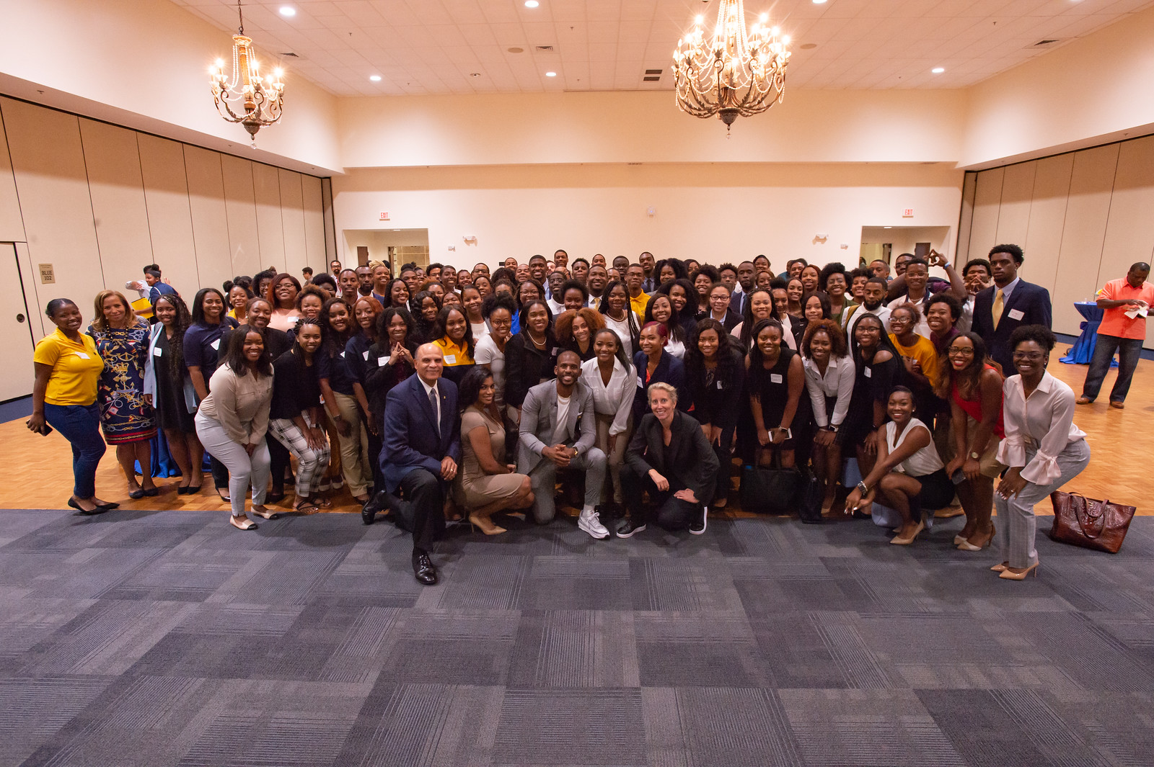
NEW DEGREE PROGRAMS
Joint Ph.D. Program in Social Work
Bachelor of Science in Health Services Management
Certificate Programs
  Data Analytics
  Data-Driven Modeling and Analysis for Complex Systems
  Environmental Engineering
  Environmental Justice
  Health & Safety
  Lactation
  Science

Slide 21
RESEARCH CENTERS
The Center for Excellence in Post-Harvest Technologies in Kannapolis, NC adds value to agricultural commodities by finding new ways to make food safer, extend shelf life and preserve health-promoting nutrients. The center forges partnerships with industry to create health enriching foods or supplements, and spur economic development in North Carolina.
The Center for Outreach in Alzheimer’s Aging and Community Health is the nation’s foremost center focusing on the disproportionate vulnerability of Alzheimer’s disease in Black communities.
The Center for Energy Research and Technology is an interdisciplinary energy research center, created to foster collaborative research and development of new energy-related technologies. CERT focuses on basic and applied research, outreach and extension activities, and education related to renewable energy, energy efficiency, alternative fuels and vehicle technologies, sustainable green buildings, and the environment.

Slide 22
RESEARCH CENTERS
The Center of Excellence in Cybersecurity, Research Education and Outreach is an inclusive community of stakeholders distinguished by interdisciplinary and innovative approaches that translate knowledge into solutions for cybersecurity challenges.
The Center of Excellence in Product Design and Advanced Manufacturing will be a leader in transformational design and manufacturing to address local and global challenges by innovating convergent solutions through inclusive partnerships.
The Center of Excellence in Entrepreneurship and Innovation aims to provide exemplary leadership in research, academic programming, and community outreach to drive economic development so the people of North Carolina can benefit from the research and innovations generated by the university. The CEEI is also a bridge between innovation and the marketplace.

Slide 23
ECONOMIC IMPACT STUDY
$1.018 Billion
in output (sales)
$604 Million
in value added (gross regional product)
$38 Million
in labor income
8,919
full and part time jobs
Commissioned by Provost Beryl McEwen to assess the economic impact of N.C. A&T in FY 2017-2018.
Conducted by Dr. Alfredo Romero and Dr. Cephas Naanwab, Associate Professors of Economics at N.C. A&T.
Designed to measure and quantify the economic the economic impact of the university in Guilford County, the Piedmont Triad, and the state of North Carolina.

Slide 24
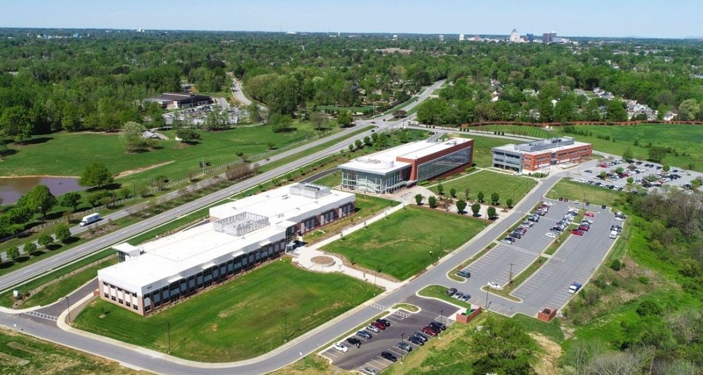
EAST GREENSBORO RENAISSANCE COMMITTEE
The East Greensboro Renaissance Committee has made tremendous strides since its inception in January 2019:
  Formed and engaged the N.C. A&T East Greensboro Renaissance Community Advisory Committee
  Completed a highest and best use analysis of East Gate City Blvd and East Market Street
  Engaged elected officials and city leadership in improvement action plans for neighborhoods surrounding the campus in East Greensboro
  Created redevelopment plan for East Market Street and retained land under site control

Slide 25
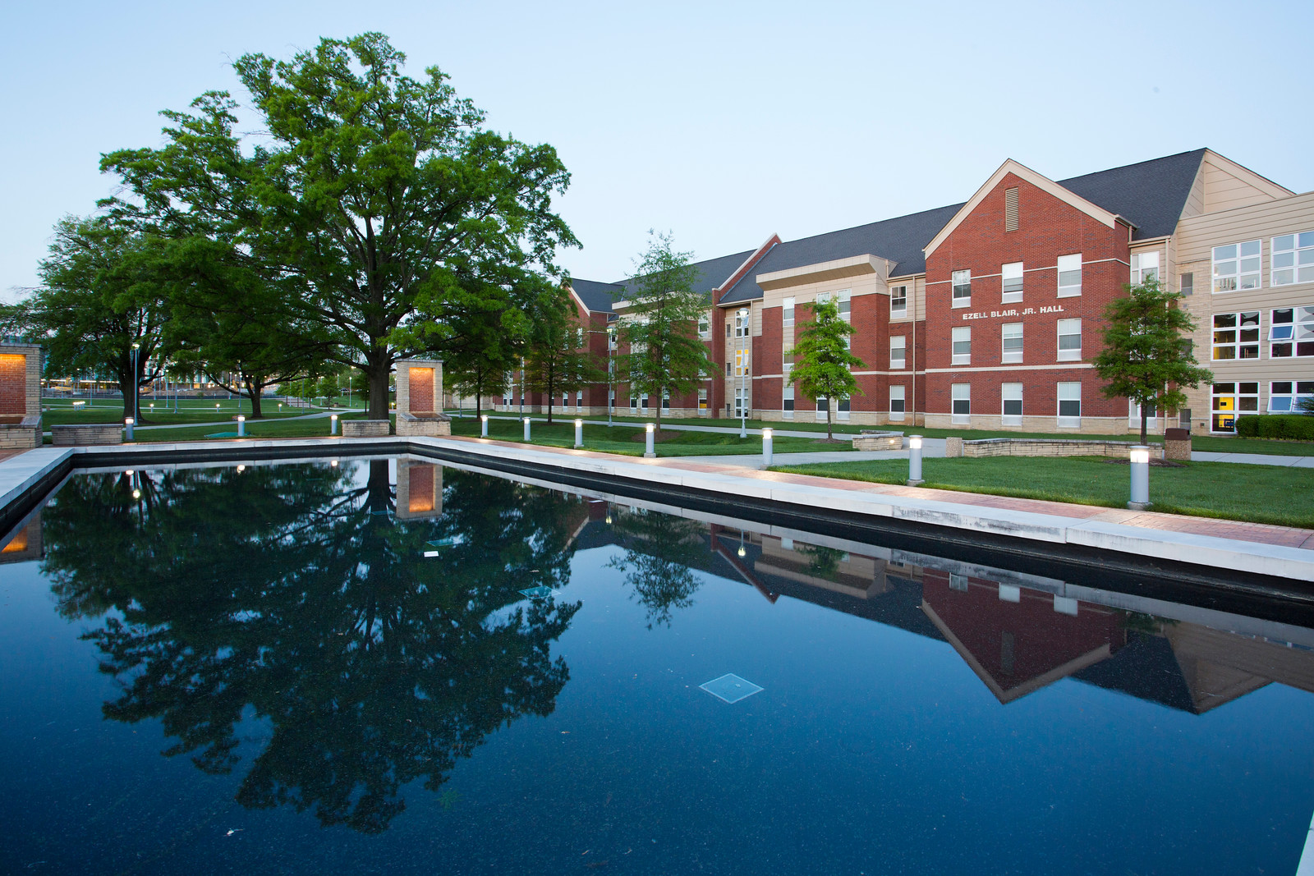
N.C. A&T REAL ESTATE FOUNDATION
The N.C. A&T Real Estate Foundation has made significant investments to fulfill its mission to support the university’s quality environment of exemplary teaching and learning, scholarly and creative research, and effective community engagement and public service through the acquisition, ownership, transfer, development, and management of real estate or real estate-related projects.
$144 Million
N.C. A&T Real Estate Foundation –
Total real estate investments

Slide 26
PIEDMONT TRIAD PARTNERSHIP
The Piedmont Triad Partnership is a private leadership organization connecting and leveraging the region’s leaders and assets to drive increased economic growth and jobs.
  PTP focuses on the Carolina Corridor, between Winston-Salem and Fayetteville at the heart of North Carolina with four new megasites of 7,200 acres of certified land that offer advanced manufacturers room to grow, as well as many other industrial sites, urban research parks and mixed-use developments.
  More than 30 colleges and universities in and around the Carolina Core, including N.C. A&T, fuel the region’s workforce, contribute to an innovation mindset and inject a vibrancy into communities.
  The Carolina Core and North Carolina at large are continually investing in workforce development initiatives, from internship and apprenticeship programs to strategic partnerships bolstering educational attainment.

Slide 27
WHAT MORE CAN WE DO TO TRANSFORM AND HAVE GREATER IMPACT ON OUR COMMUNITY, REGION, AND STATE?

Slide 28
THANK YOU

