Slide 1
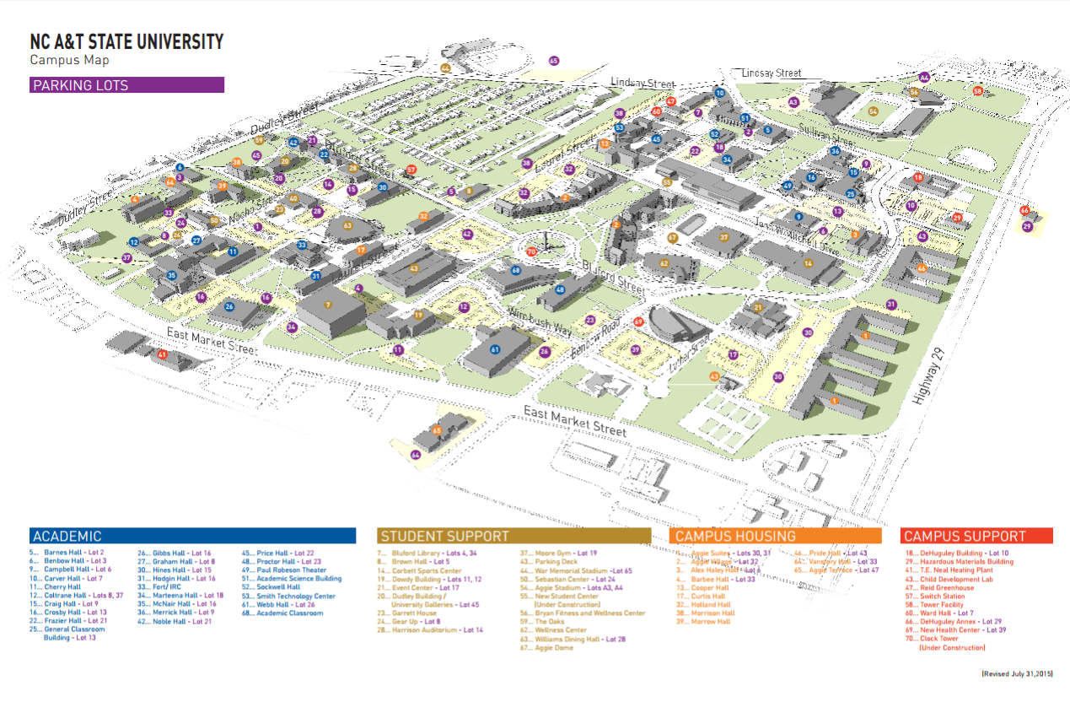
40..Murphy Hall

Slide 2
Completed Locations
Academic Classroom (#68) 2nd & 3rd Floor Corridors
Campus Recreation Center (#62) 1st Floor Main Corridor
Gibbs Hall (#26) 1st Floor Main Lobby
Harrison Auditorium (#28) 2nd Floor Balcony
Noble Hall (#42) 2nd Floor Corridor
Webb Hall (#61) 2nd Floor West Corridor
Benbow Hall (#6) 2nd Floor Corridor
Bluford Library (#7) 1st Floor (Near staff elevator)
Campbell Hall (#9) 1st Floor Corridor
Corbett Sports Center (#14) 2nd Floor Corridor
Price Hall (#45) 1st Floor Main Corridor
Murphy Hall (#40) Lower Level
(#) building location on map

Slide 3
Residence Halls Completed
# of # of
Restrooms Restrooms
Aggie Suites E (#1) 2 McCain Hall (#2) 4
Aggie Suites F (#1) 2 McNeil Hall (#2) 4
Barbee Hall (#4) 2 Morrison Hall (#38) 1
Blair Hall (#2) 4 Morrow Hall (#39) 1
Cooper Hall (#13) 2 Pride Hall (#46) 2
Curtis Hall (#17) 1 Richmond Hall (#2) 4
Haley Hall (#3) 2 Vanstory Hall (#64) 1
(#) Building number and location on map

